Slide 1

Data-X : Machine Learning (Classification)
Data ^{X}
About Me:
Ikhlaq Sidhu Chief Scientist & Founding Director, Sutardja Center for Entrepreneurship & Technology IEOR Emerging Area Professor Award, UC Berkeley

Slide 2
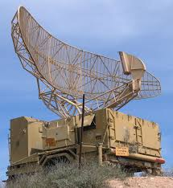
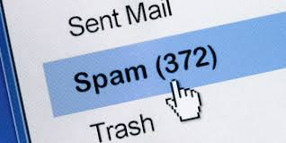
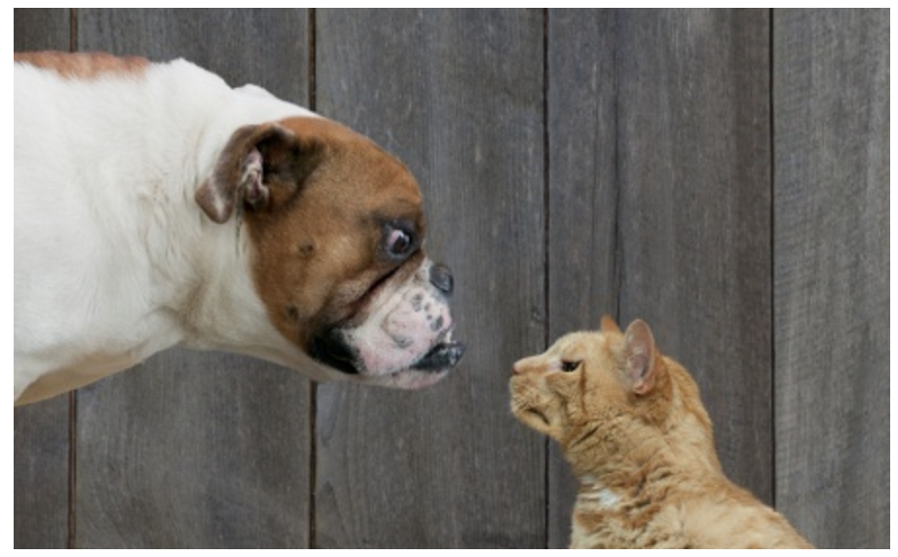
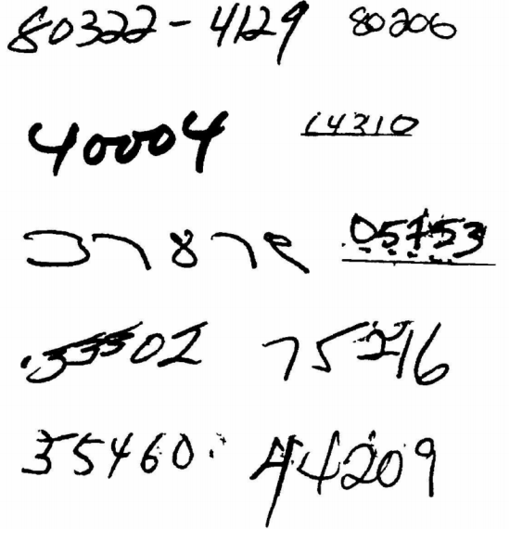
Classification
Classification
Examples
Radar: WWII
Spam Detection
Image Classification: Cats VS Dogs
Image Classification: Recognizing Digits

Slide 3
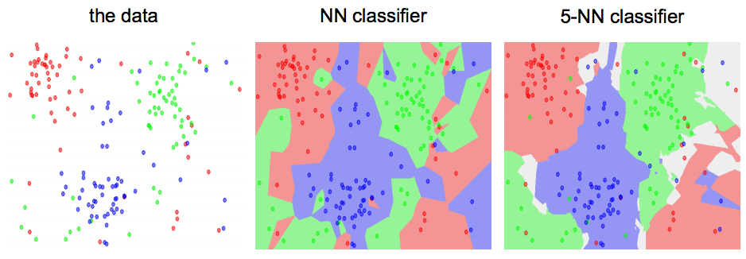
An example: k-nearest neighbor
Goal: Classify incoming data based on collected datasets
Method: Find the k nearest images and have them vote on the label (i.e. take the mode)
Ref: https://en.wikipedia.org/wiki/K-nearest_neighbors_algorithm

Slide 4
Question: Can we do better?

Slide 5

Yes!
The Key is multi-layer learning algorithms such as Deep CNNs!

Slide 6
Classifiers: A Whirlwind Tour
Linear Classifiers
The simplest parametric classifier
One must define a loss function in order to optimize the weights of a linear classifier
Regularization is your friend!
Examples: Support Vector Machine (SVM) & Logistic Classifier
Nonlinear Classifiers
Introduction to Neural Networks (an universal function approximator)

Slide 7
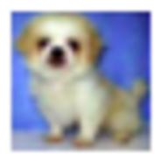
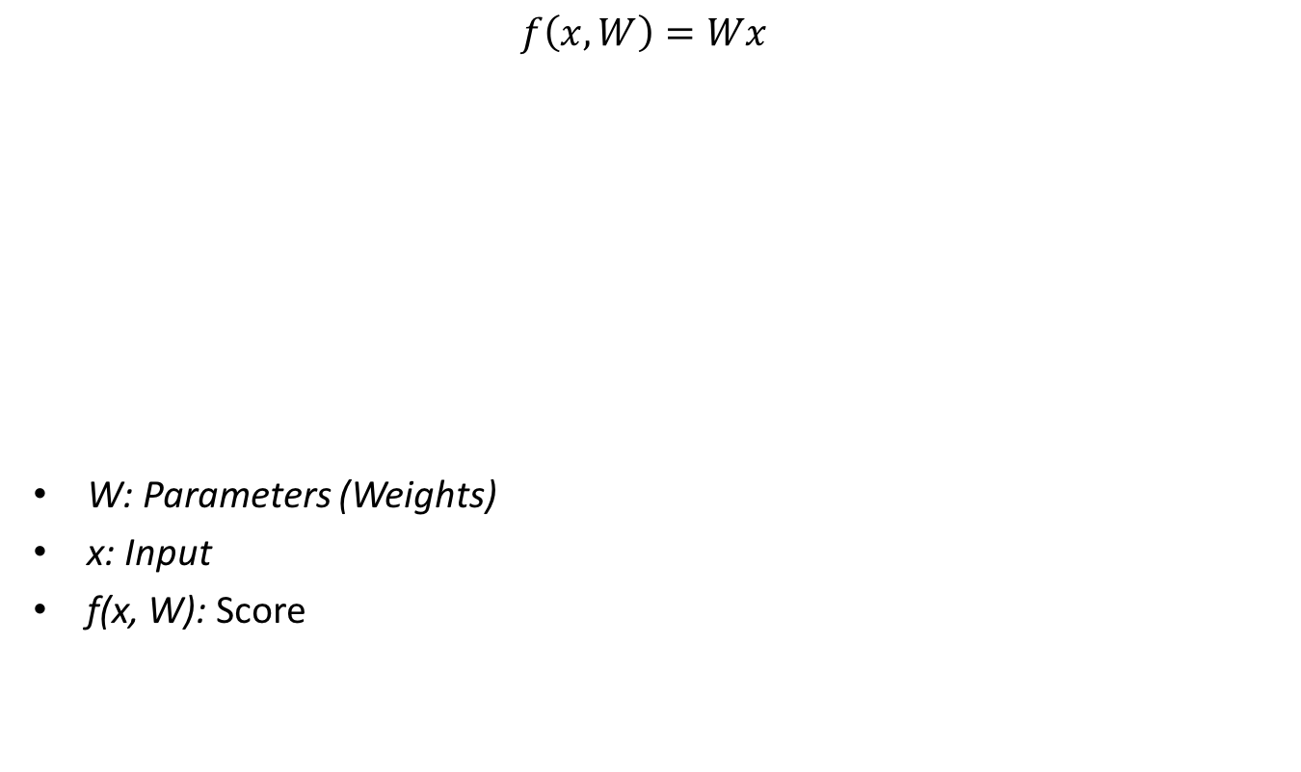
Parametric Classifiers
$$f\left(x, W\right)=Wx$$
W: Parameters (Weights)
x: Input
f(x, W): Score
10 numbers indicating class scores
[32 x 32 x 3] array of numbers

Slide 8
Next Steps
Define a loss function that captures the performance of the classifier
Optimize across the parameter space in order to minimize the loss function
We will use 2 examples to illustrate how to design, analyze, and interpret classification algorithms:
Support Vector Machine (SVM)
Logistic Classifier

Slide 9
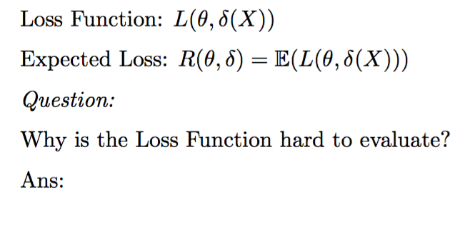
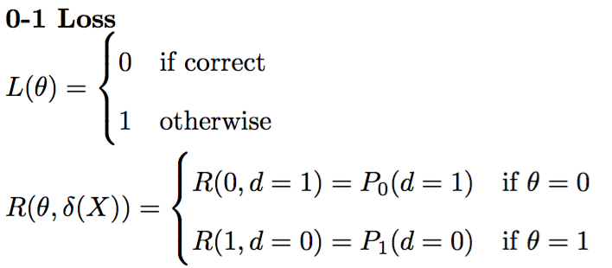
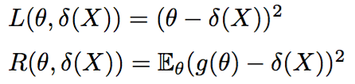
Classical Loss Functions
Classification Errors
Squared Errors

Slide 10
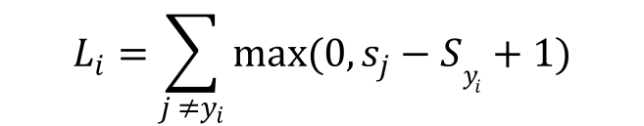
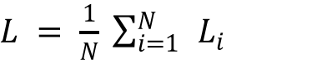
Multiclass SVM Loss
Given an example: (x_{i}, y_{i}) : x_{i} is the predictors/image and y_{i} is the label/response
Define s = f(x_{i}, W)
S is a vector and the label with the highest score is the best prediction
The SVM Loss has the form:
$$L_{i}=\sum_{j ≠y_{i}}{max(0, s_{j}−Sy_{i}+1)}$$
For sample i
$L = \frac{1}{N} \sum_{i=1 }^{N}{{ L}_{i}}$
For Full Dataset

Slide 11
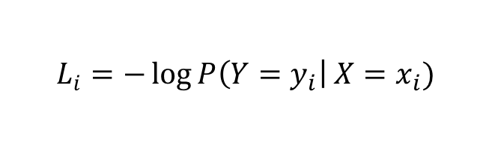
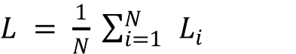
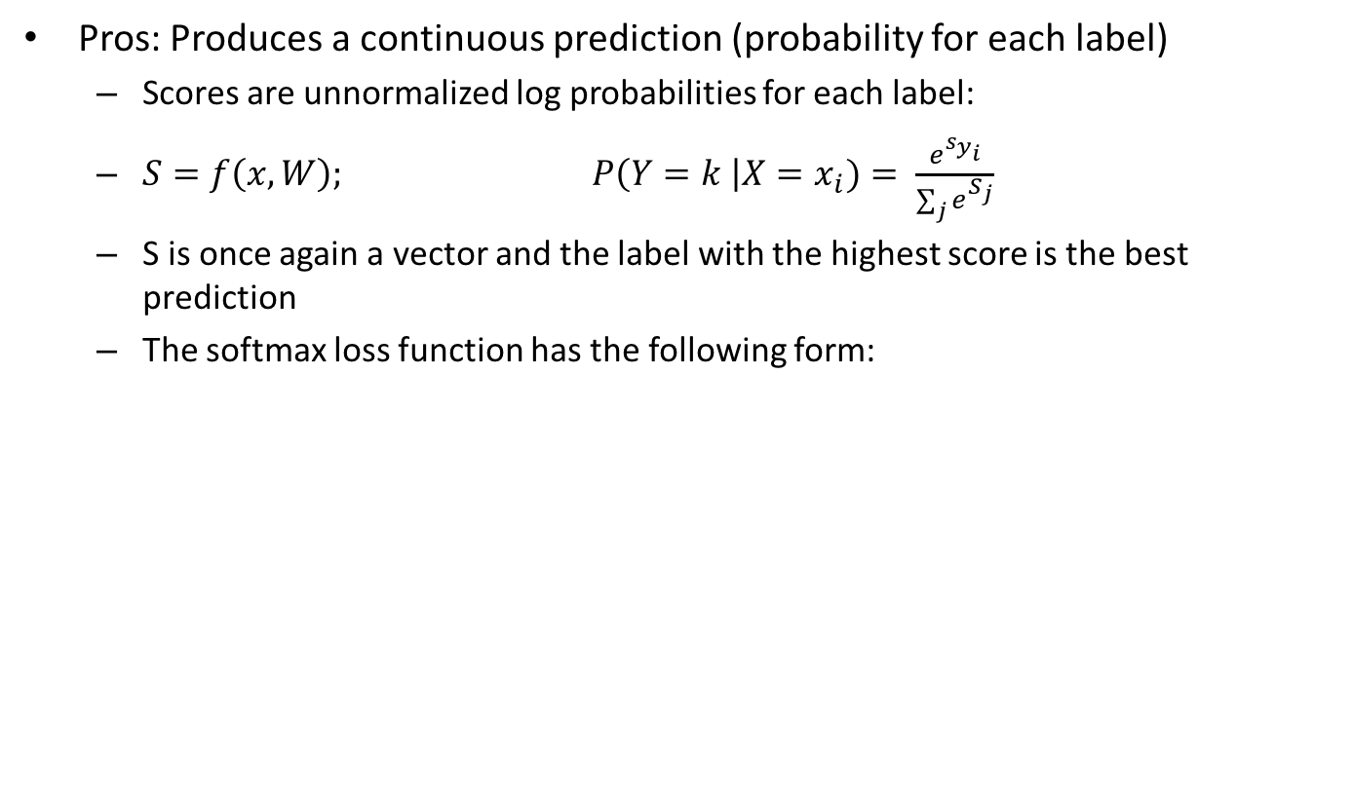
Softmax Classifier (Multinomial Logistic Regression)
Pros: Produces a continuous prediction (probability for each label)
Scores are unnormalized log probabilities for each label:
$S=f\left(x, W\right); P\left(Y=k \right|X=x_{i})= \frac{e^{s_{y_{i}}}}{\sum_{j}{e^{S_{j}}}}$
S is once again a vector and the label with the highest score is the best prediction
The softmax loss function has the following form:
Softmax function
$$L_{i}=−\log{P\left(Y=y_{i}\right| X=x_{i})}$$
For sample i
$L = \frac{1}{N} \sum_{i=1 }^{N}{{ L}_{i}}$
For Full Dataset

Slide 12
Optimization
One can make a random guess/initialization of the parameters: W and b, however the outcome will likely be unsatisfactory
Question:
How can we do better?
How can we utilize the data we have to select W and b such that the data loss is small?
Random search works extremely poorly
Stochastic Gradient Descent (type) algorithms tend be the choice
Key Idea: Follow the slope and use first order gradient information
2nd Order Methods: L-BFGS are not practical at the moment
Variants:
Stochastic Gradient Descent
Nesterov/Momentum
ADAGRAD
RMSprop
ADAM
To-Do: Based on how much we want to teach and expect them to know, the section on optimization has to be adjusted

Slide 13
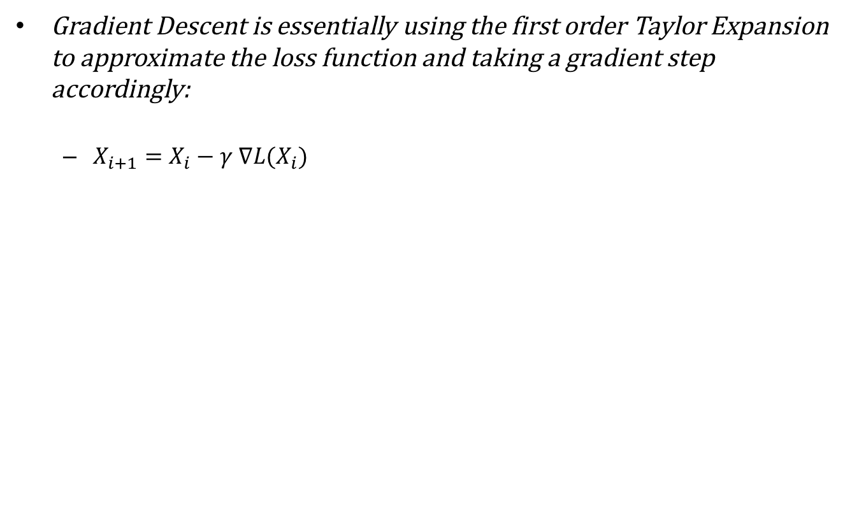
First Order Methods: Gradient Descent
Gradient Descent is essentially using the first order Taylor Expansion to approximate the loss function and taking a gradient step accordingly:
$X_{i+1}=X_{i}−γ ∇L(X_{i})$

Slide 14
Regularization
It is well known that neural networks can result in overfitting especially when one considers complex deep neural networks
There are several ways to control the extend of overfitting in order to generalize better when the model faces fresh data points
Shrinkage Methods:
L2-regularization
L1-regularization
Elastic Net
Max-Norm constraints
Dropout (Srivastava, Hinton et al., 2014)
Specifically for neural networks
Will be discussed later (Maybe?)

Slide 15
Shrinkage Methods
Regularization term:

Slide 16
End of Section

